Slide 1


Taylor Swift spotify analysis
currently in my midnights era!
By: Yashi Bajpai

Slide 2
Table of contents
01
02
03
04
05
Introduction
Methodology
Results
Future Work
Appendix

Slide 3
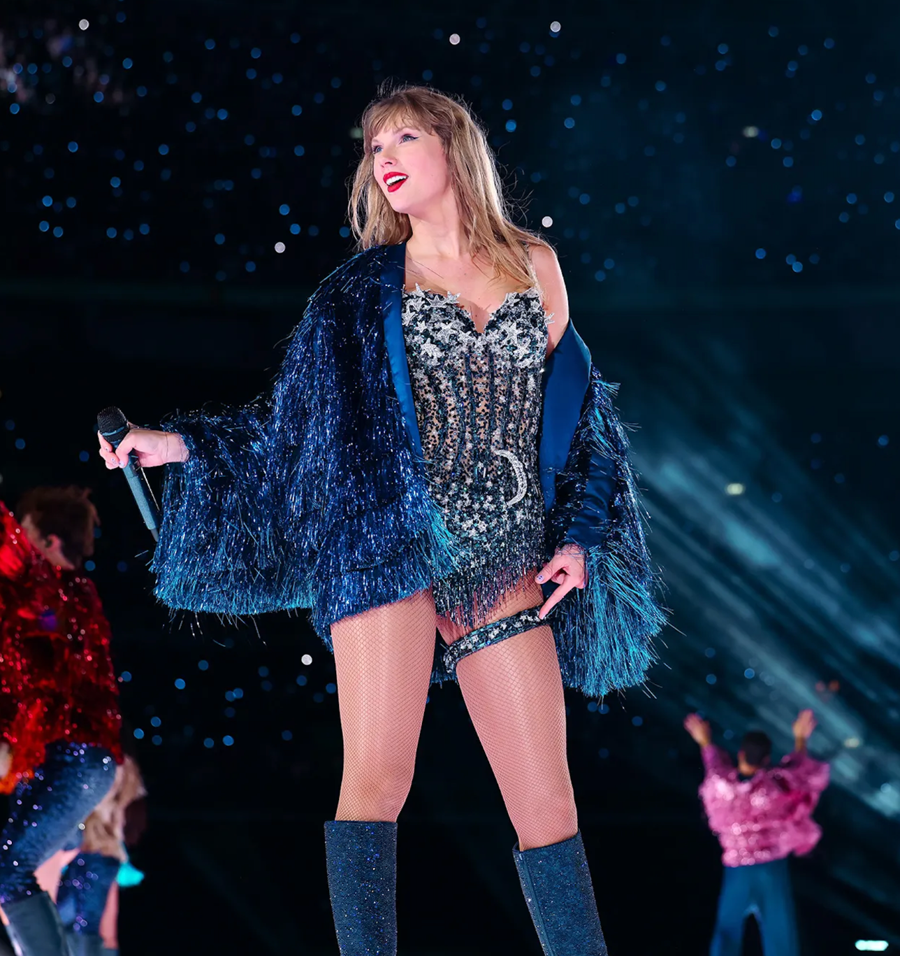

01
Introduction

Slide 4
Purpose: Analyzing Taylor Swift’s Spotify data and the attributes of her tracks to uncover insights useful for personalizing user experiences on smaller streaming platforms

Slide 5
Overall Question: What trends exist in Taylor Swift’s music in terms of popularity and energy?
Questions Answered in Analysis:
Which Taylor Swift albums are the most popular based on Spotify popularity scores?
How do the energy levels of tracks vary across different albums?
Is there a correlation between the average energy and popularity of her albums?

Slide 6
People Who Benefit:
Smaller Music Streaming Platforms (Tidal, Deezer, SiriusXM)

Slide 7
02
Methodology

Slide 8
Dataset: taylor_swift_spotify.csv -> downloaded from Kaggle
contains detailed Spotify analytics with track attributes for Taylor Swift’s music

Slide 9
Unit of Analysis: Song from Taylor Swift’s discography
Characteristics/Features: Track Name, Track Album, Track Popularity, Track Energy

Slide 10
Environment: Jupyter Notebook
Language: Python & Markdown
Libraries: Pandas, Mathplotlib, Seaborn

Slide 11
03
Results

Slide 12
Question #1 - Which Taylor Swift albums are the most popular based on Spotify popularity scores?
Conclusion: Top Five - Lover, The Tortured Poets Department, Reputation, Midnights, and Folklore

Slide 13
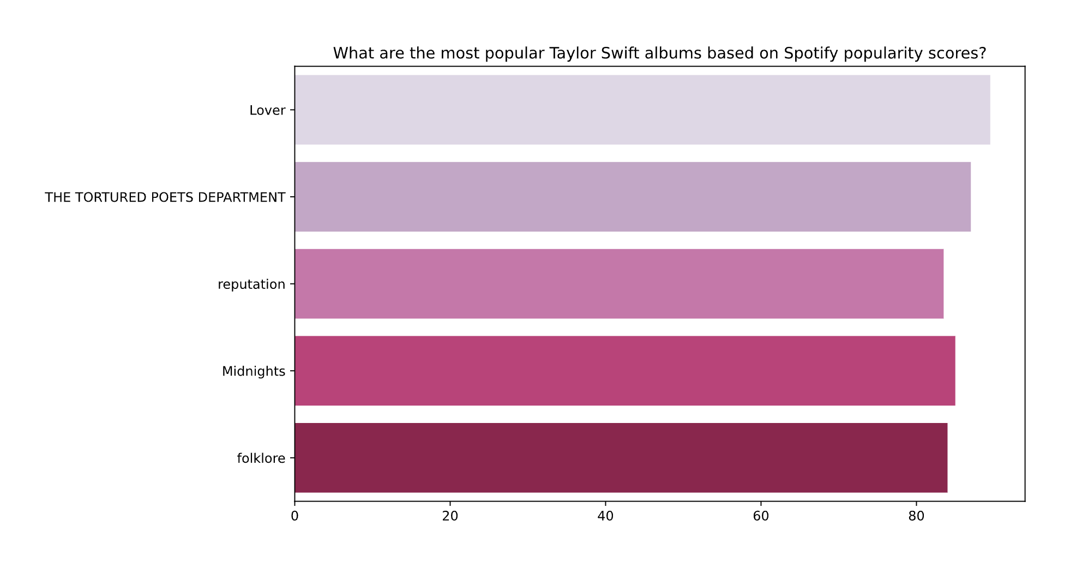
Question #1 Plot

Slide 14
Question #1 Aftermath:
Lover, Reputation, and Midnights completely make sense to me as they broke records
Folklore mainly makes sense, has some hit songs (Cardigan) but some tracks are insanely underrated
probably due to lyricism
I’m surprised that 1989 isn’t here, as it has a lot of Taylor’s biggest radio hits (Shake It Off, Blank Space)

Slide 15
Question #2 - How do the energy levels of tracks vary across different albums?
Highest Energy: 1989 and Speak Now
upbeat and lively tracks
Lowest Energy: Folklore and Midnights
softer, more laid-back tracks

Slide 16
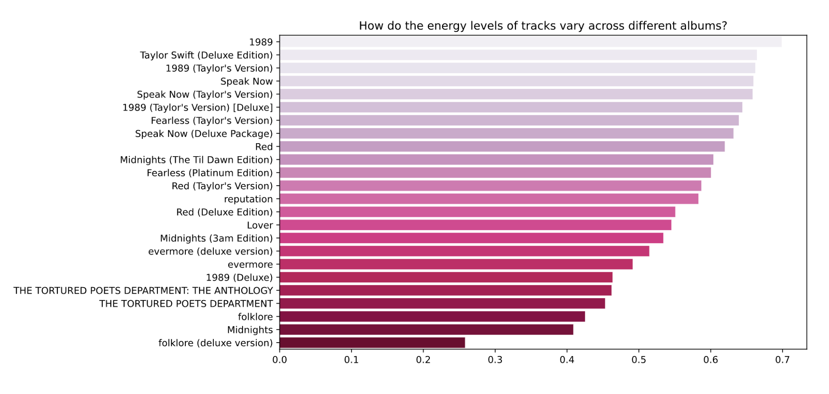
Question #2 Plot

Slide 17
Question #2 Aftermath:
Out of all three questions, these results make the most sense (from personal listening experience)
made me realize that the decision to listen to an album depends on the person’s mood and the album’s energy (vibes)

Slide 18
Question #3 - Is there a correlation between the average energy and popularity of her albums?
Conclusion: Slight negative correlation between energy and popularity scores, indicating higher energy may not strongly drive popularity

Slide 19
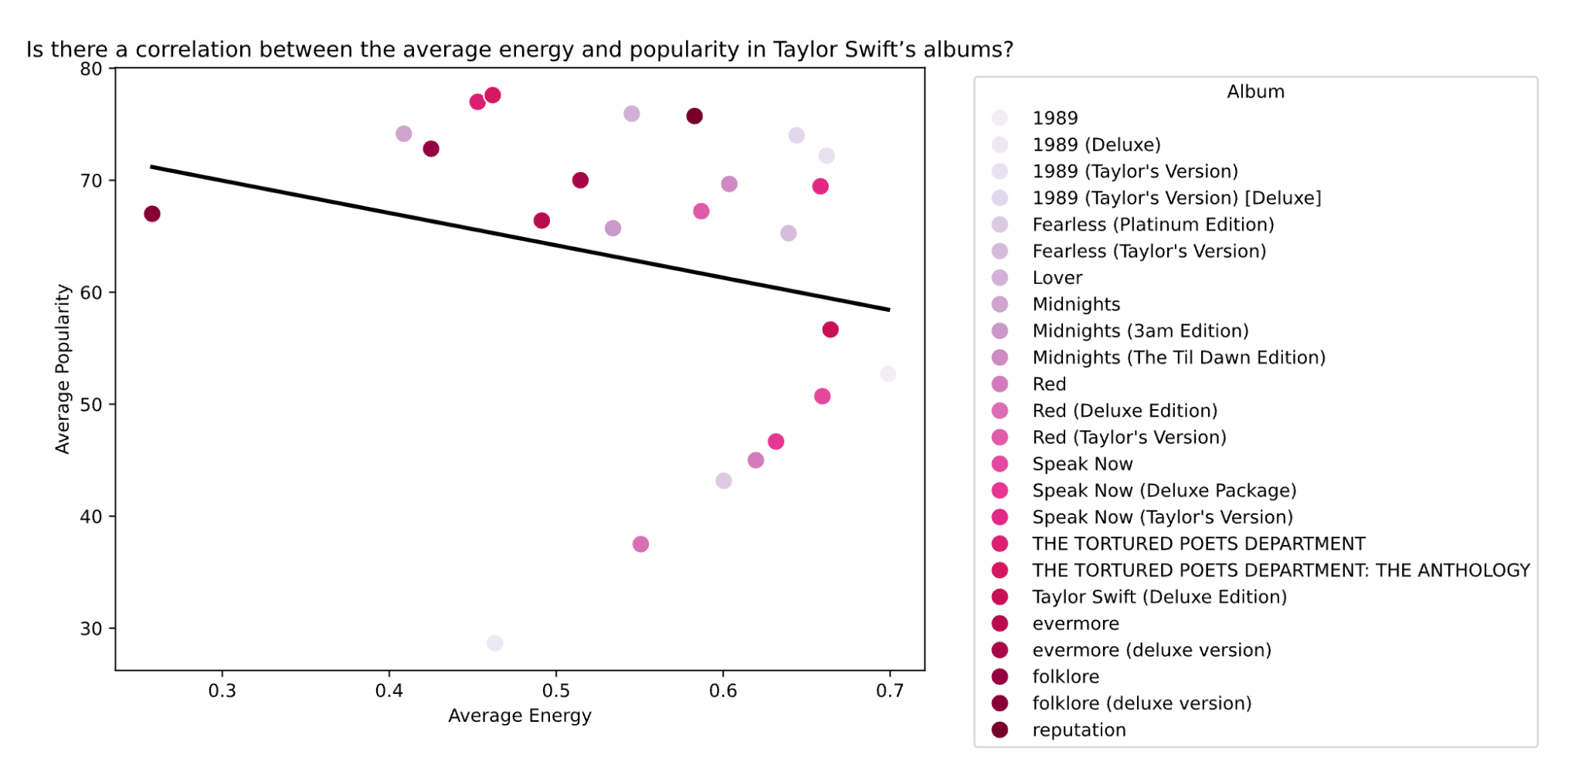
Question #3 Plot

Slide 20
Question #3 Aftermath:
This conclusion makes sense to me
a lot of Swifties tend to listen to certain albums/tracks for the relatability and lyricism rather than energy levels
the top five albums, are said to be Taylor’s most relatable/lyrically sound albums

Slide 21
04
Future Work

Slide 22
Analyzing additional song attributes like danceability and acousticness for more detailed analysis
Comparing Taylor Swift’s music trends to other artists to determine unique patterns within the genre
Doing an analysis of what people think are the most relatable and/or lyrically sound albums, then analyzing the correlation with the popularity
seeing how it compares to energy/popularity

Slide 23
Thanks for listening
any questions?

